Slide 1




New Circuit Lower Bounds via Solving Range Avoidance
Lijie Chen
UC Berkeley
Shuichi Hirahara
National Institute of Informatics
Hanlin Ren
University of Oxford
Zeyong Li
National University of Singapore
https://eccc.weizmann.ac.il/report/2023/144/
https://eccc.weizmann.ac.il/report/2023/156/

Slide 2
Today’s Plan
Motivation, Background, New Results:
New Maximum Circuit Lower Bounds
New Algorithms for Range Avoidance
Proof Overview:
Korten’s algorithm
An Infinitely-often algorithm for range avoidance via Iterative win-win [CHR’23]
An almost-everywhere algorithm for range avoidance [Li’23]

Slide 3

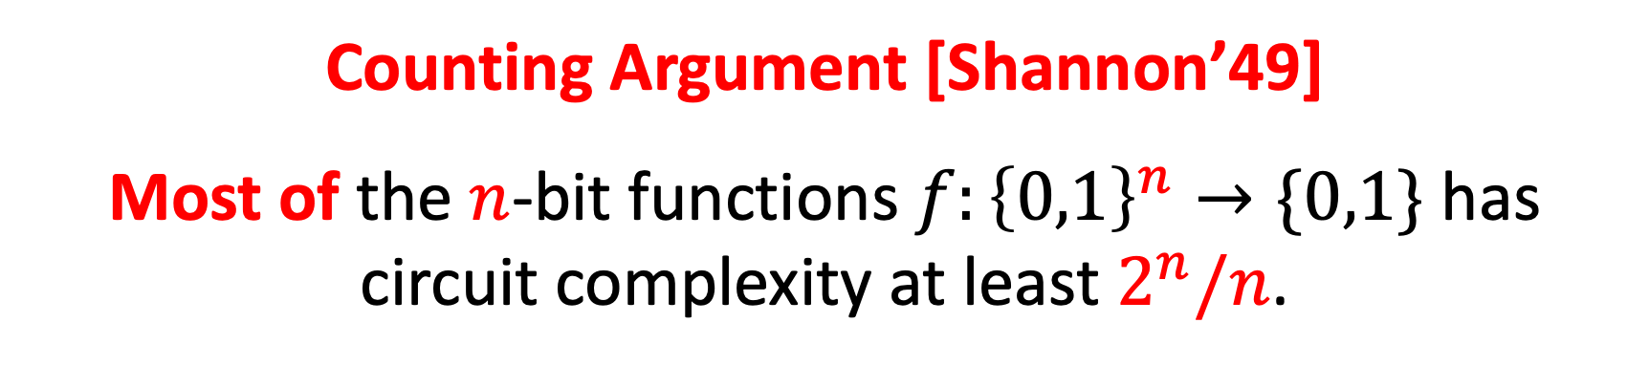

Motivation: Exponential Circuit Lower Bounds
Counting Argument [Shannon’49]
Most of the $n$-bit functions $f:{\left\{0,1\right\}}^{n}→\{0,1\}$ has circuit complexity at least $2^{n}/n$.
A Fundamental Challenge of Complexity Theory
Can we find an explicit $f$ that requires $2^{Ω(n)}$-size circuits?
In other words, what is the smallest complexity class that contains a function requiring $2^{Ω(n)}$-size circuits?

Slide 4
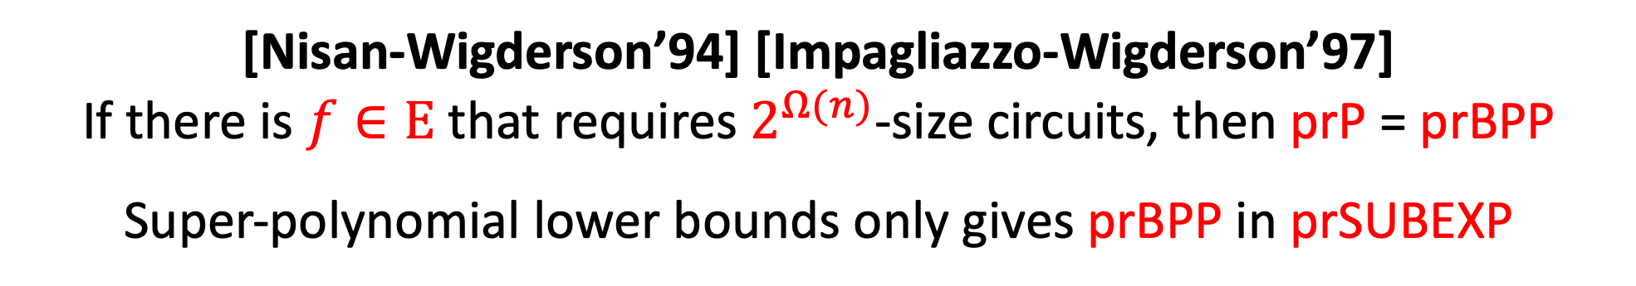
Motivation: Exponential Circuit Lower Bounds
Counting Argument [Shannon’49]
Most of the $n$-bit functions $f:{\left\{0,1\right\}}^{n}→\{0,1\}$ has circuit complexity at least $2^{n}/n$.
Exponential Circuit Lower Bounds are Important
[Nisan-Wigderson’94] [Impagliazzo-Wigderson’97]
If there is $f∈E$ that requires $2^{Ω(n)}$-size circuits, then prP = prBPP Super-polynomial lower bounds only gives prBPP in prSUBEXP

Slide 5

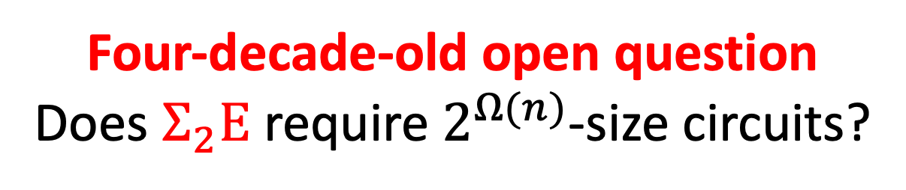
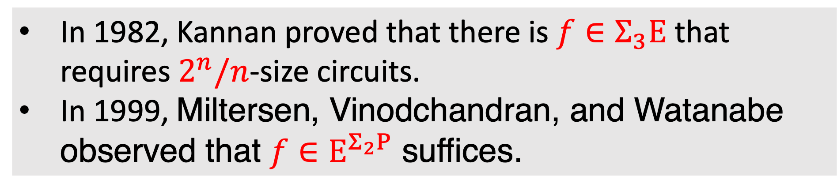
Exponential Circuit Lower Bounds: What’s Known
In 1982, Kannan proved that there is $f∈Σ_{3}E$ that requires $2^{n}/n$-size circuits.
In 1999, Miltersen, Vinodchandran, and Watanabe observed that $f∈E^{Σ_{2}P}$ suffices.
These are all we knew before 2023
Four-decade-old open question
Does $Σ_{2}E$ require $2^{Ω(n)}$-size circuits?

Slide 6
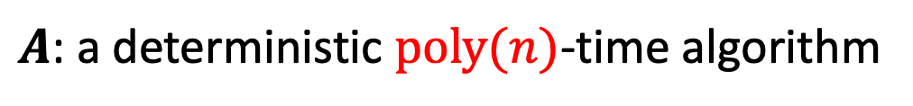
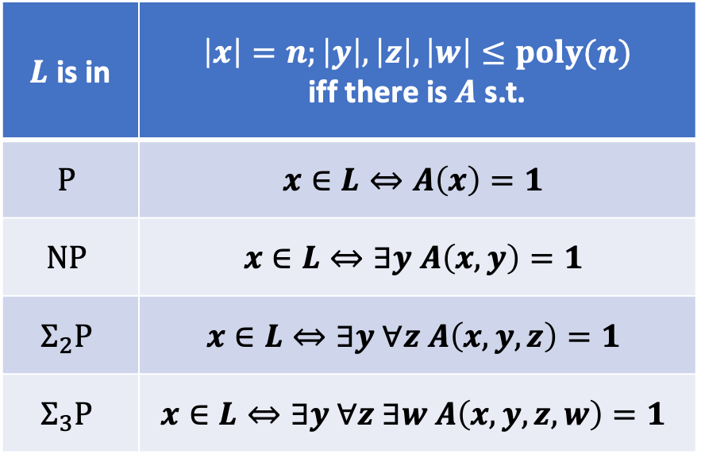
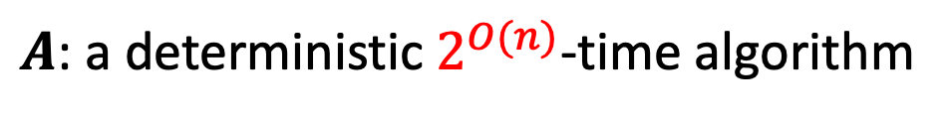
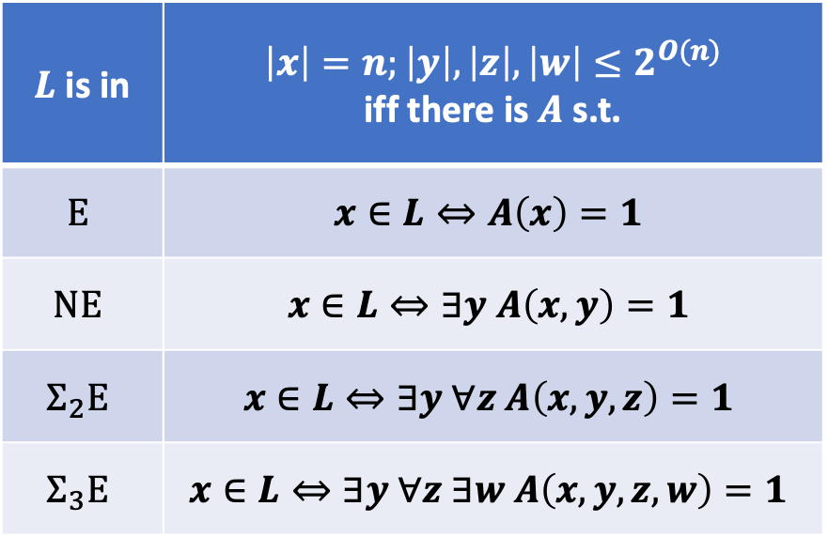
Complexity Theory 201
The Polynomial Hierarchy
The Exponential Hierarchy
$A$: a deterministic $poly(n)$-time algorithm
$A$: a deterministic $2^{O(n)}$-time algorithm
$L$ is in | $$\left|x\right|=n;\left|y\right|,\left|z\right|,\left|w\right|≤poly(n)$$ iff there is $A$ s.t.
$$P$$ | $$x∈L⇔A\left(x\right)=1$$
$$NP$$ | $$x∈L⇔∃y A\left(x,y\right)=1$$
$$Σ_{2}P$$ | $$x∈L⇔∃y ∀z A\left(x,y,z\right)=1$$
$$Σ_{3}P$$ | $$x∈L⇔∃y ∀z ∃w A\left(x,y,z,w\right)=1$$
$L$ is in | $$\left|x\right|=n;\left|y\right|,\left|z\right|,\left|w\right|≤2^{O(n)}$$ iff there is $A$ s.t.
$$E$$ | $$x∈L⇔A\left(x\right)=1$$
$$NE$$ | $$x∈L⇔∃y A\left(x,y\right)=1$$
$$Σ_{2}E$$ | $$x∈L⇔∃y ∀z A\left(x,y,z\right)=1$$
$$Σ_{3}E$$ | $$x∈L⇔∃y ∀z ∃w A\left(x,y,z,w\right)=1$$

Slide 7


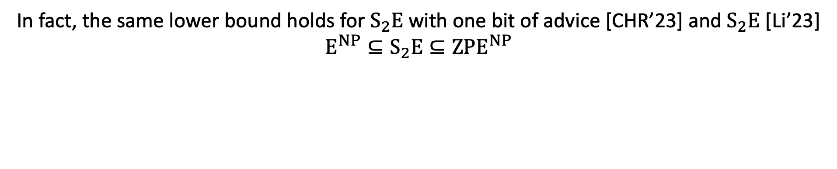
(Finally) New Results
[Chen-Hirahara-Ren’23]
There is $L∈Σ_{2}E$ requiring $2^{n}/n$-size circuits.
[Li’23]
There is $L∈Σ_{2}E$ requiring $2^{n}/n$-size circuits, on all input lengths.
In fact, the same lower bound holds for $S_{2}E$ with one bit of advice [CHR’23] and $S_{2}E$ [Li’23] $$E^{NP}⊆S_{2}E⊆{ZPE}^{NP}$$

Slide 8

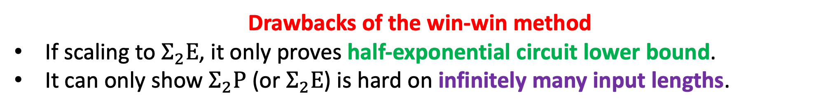
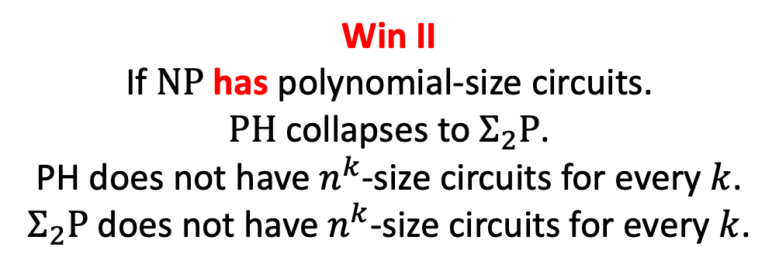
Win-win method in proving circuit lower bounds
Kannan proved $Σ_{2}P$ does not have $n^{k}$-size circuits for every $k$.
Win II
If $NP$ has polynomial-size circuits.
$PH$ collapses to $Σ_{2}P$.
PH does not have $n^{k}$-size circuits for every $k$.
$Σ_{2}P$ does not have $n^{k}$-size circuits for every $k$.
Win I
If $NP$ does not have polynomial-size circuits.
DONE
Key idea: case analysis depending on whether NP has polynomial-size circuits or not.
Drawbacks of the win-win method
If scaling to $Σ_{2}E$, it only proves half-exponential circuit lower bound.
It can only show $Σ_{2}P$ (or $Σ_{2}E$) is hard on infinitely many input lengths.

Slide 9
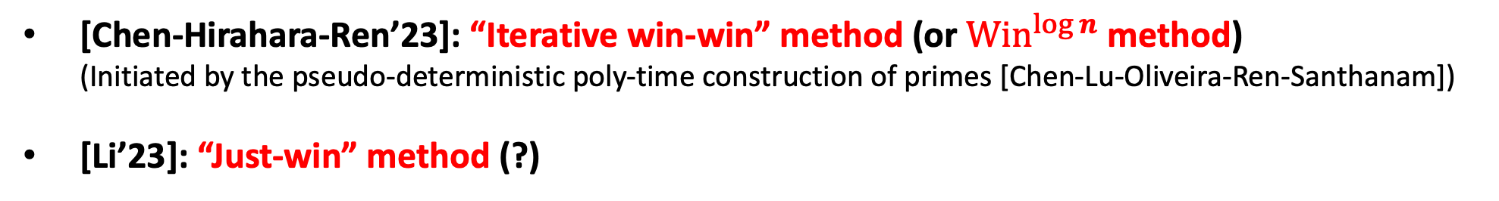

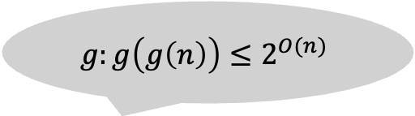
Win-win method in proving circuit lower bounds
$$g:g\left(g\left(n\right)\right)≤2^{O(n)}$$
Drawbacks of the win-win method
If scaling to $Σ_{2}E$, it only proves half-exponential circuit lower bound.
It can only show $Σ_{2}P$ (or $Σ_{2}E$) is hard on infinitely many input lengths.
For the last four decades, all lower bounds against unrestricted circuits follow the win-win method. (To the best of my knowledge.)
In 2023 we have two new techniques! (both drawbacks are addressed)
[Chen-Hirahara-Ren’23]: “Iterative win-win” method (or ${Win}^{log n}$ method) (Initiated by the pseudo-deterministic poly-time construction of primes [Chen-Lu-Oliveira-Ren-Santhanam])
[Li’23]: “Just-win” method (?)

Slide 10
Today’s Plan
Motivation, Background, New Results:
New Maximum Circuit Lower Bounds
New Algorithms for Range Avoidance
Proof Overview:
Korten’s algorithm
An Infinitely-often algorithm for range avoidance via Iterative win-win [CHR’23]
An almost-everywhere algorithm for range avoidance [Li’23]

Slide 11
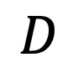
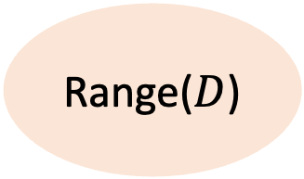
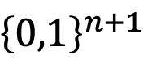
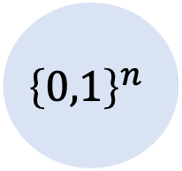
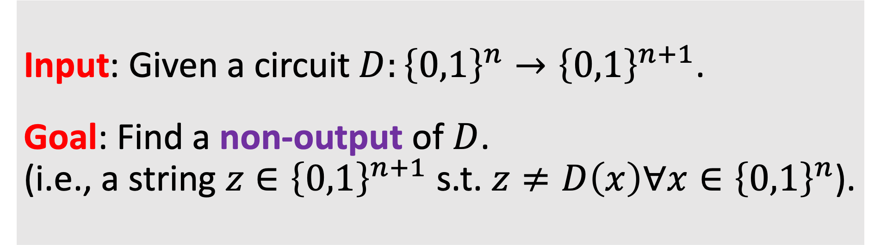

Range Avoidance
Input: Given a circuit $D:{\left\{0,1\right\}}^{n}→{\left\{0,1\right\}}^{n+1}$.
Goal: Find a non-output of $D$. (i.e., a string $z∈{\left\{0,1\right\}}^{n+1}$ s.t. $z≠D\left(x\right)∀x∈{\left\{0,1\right\}}^{n}$).
A non-output
$${\left\{0,1\right\}}^{n+1}$$
$${\left\{0,1\right\}}^{n}$$
$$z$$
Range($D$)
$$D$$

Slide 12
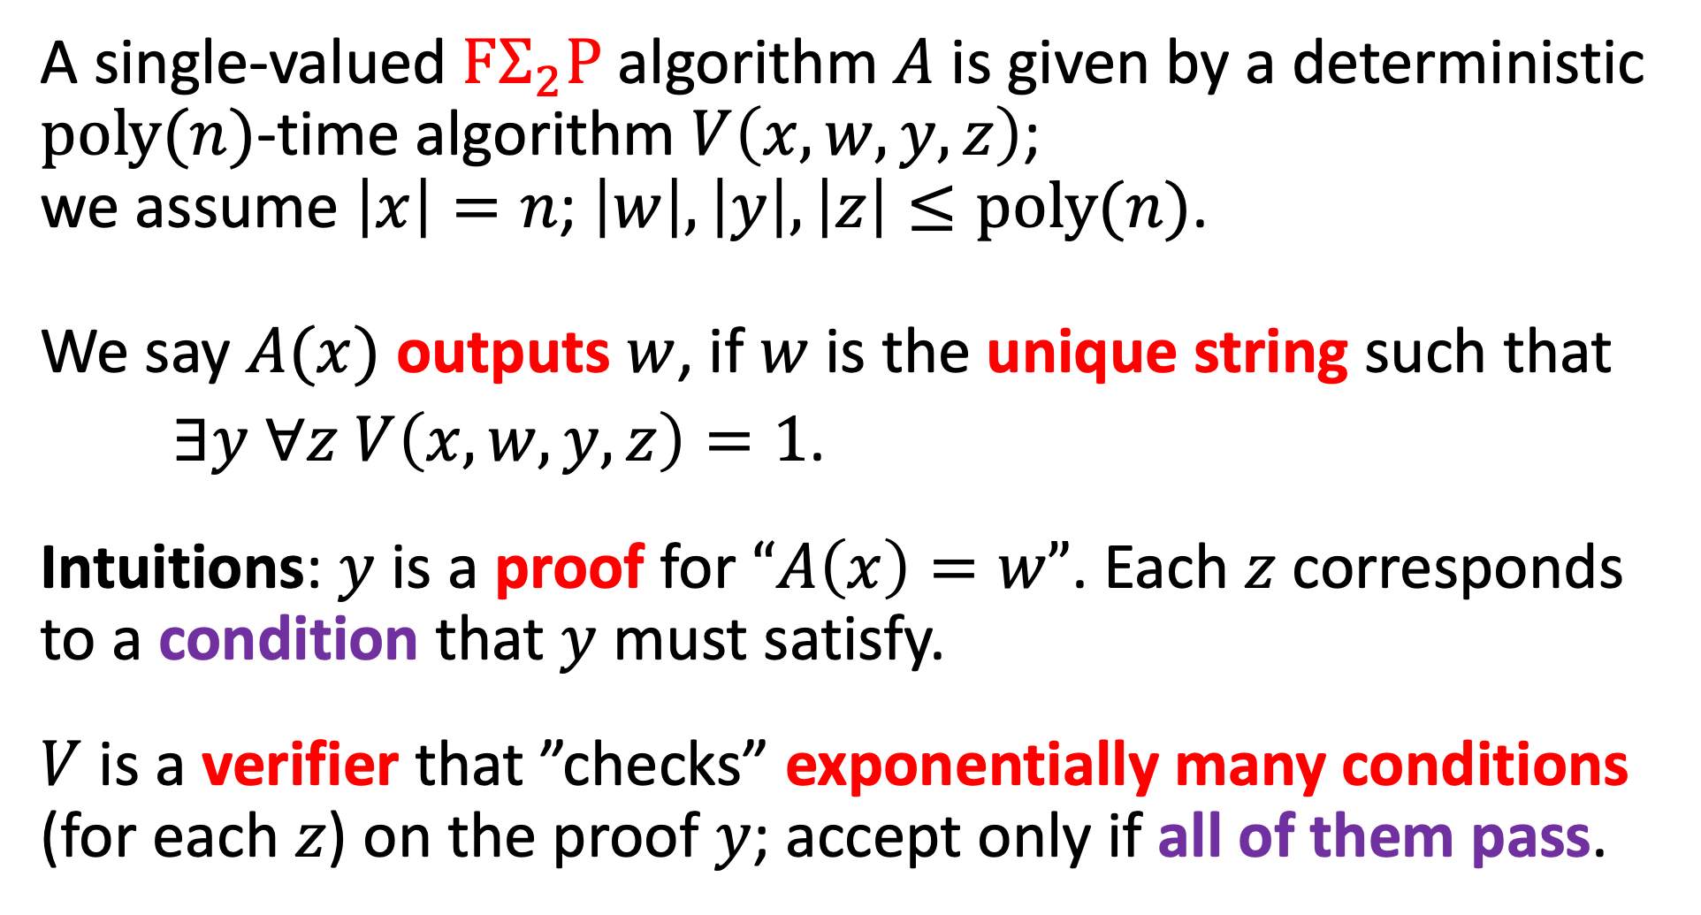

Single-valued $FΣ_{2}P$ Algorithm
A single-valued $FΣ_{2}P$ algorithm $A$ is given by a deterministic $poly(n)$-time algorithm $V\left(x,w,y,z\right)$; we assume $\left|x\right|=n$; $\left|w\right|,\left|y\right|,\left|z\right|≤poly(n)$.
We say $A(x)$ outputs $w$, if $w$ is the unique string such that
$∃y ∀z$ $V\left(x,w,y,z\right)=1$.
Intuitions: $y$ is a proof for $“A\left(x\right)=w”$. Each $z$ corresponds to a condition that $y$ must satisfy.
$V$ is a verifier that ”checks” exponentially many conditions (for each $z$) on the proof $y$; accept only if all of them pass.

Slide 13


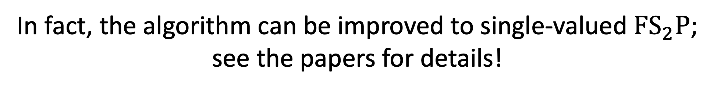
Results
[Chen-Hirahara-Ren’23]
There is a single-valued $FΣ_{2}P$-algorithm for range avoidance that works on infinitely many input lengths.
[Li’23]
There is a single-valued $FΣ_{2}P$-algorithm for range avoidance that works on all input lengths.
In fact, the algorithm can be improved to single-valued ${FS}_{2}P$; see the papers for details!

Slide 14

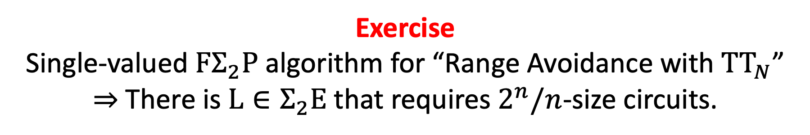
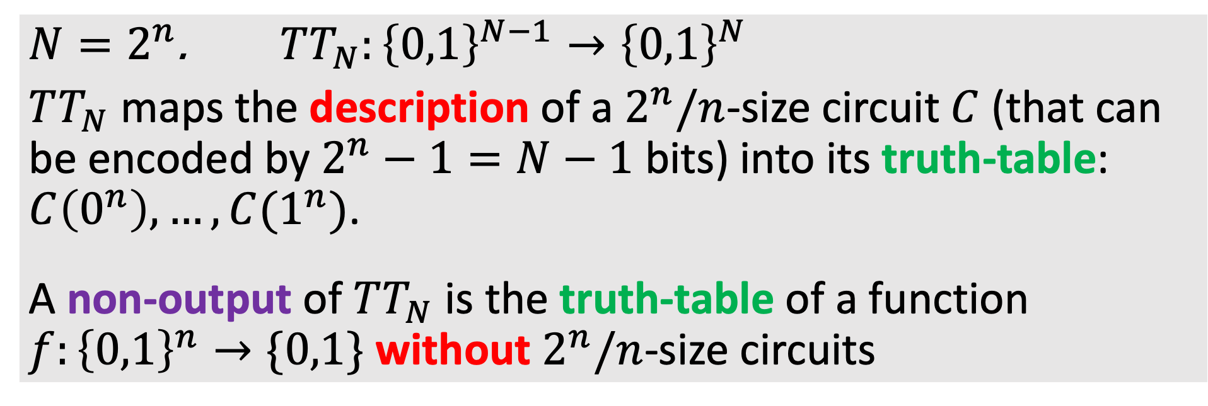
Circuit Lower Bounds from Range Avoidance
$N=2^{n}$. $TT_{N}:{\left\{0,1\right\}}^{N−1}→{\left\{0,1\right\}}^{N}$
$TT_{N}$ maps the description of a $2^{n}/n$-size circuit $C$ (that can be encoded by $2^{n}−1=N−1$ bits) into its truth-table: $C\left(0^{n}\right),…,C(1^{n})$.
A non-output of $TT_{N}$ is the truth-table of a function $f:{\left\{0,1\right\}}^{n}→\{0,1\}$ without $2^{n}/n$-size circuits
Exercise Single-valued $FΣ_{2}P$ algorithm for “Range Avoidance with ${TT}_{N}$”
$⇒$ There is $L∈Σ_{2}E$ that requires $2^{n}/n$-size circuits.

Slide 15
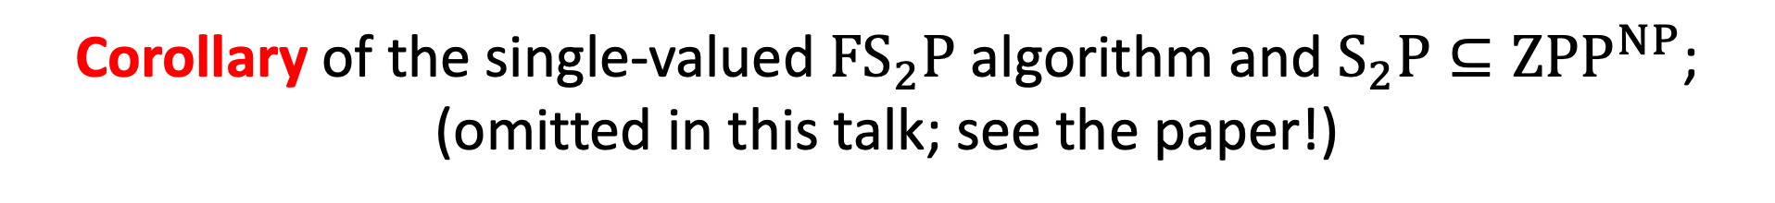
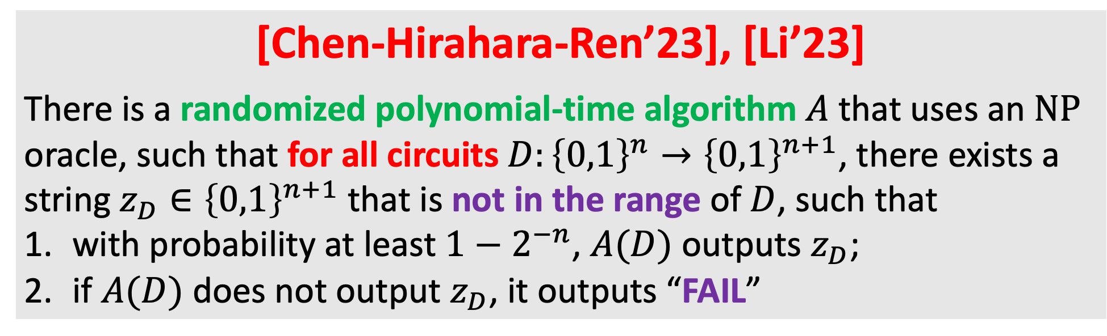
Corollary: Zero-error Pseudo-deterministic Algorithm for Range Avoidance
[Chen-Hirahara-Ren’23], [Li’23]
There is a randomized polynomial-time algorithm $A$ that uses an $NP$ oracle, such that for all circuits $D:{\left\{0,1\right\}}^{n}→{\left\{0,1\right\}}^{n+1}$, there exists a string $z_{D}∈{\left\{0,1\right\}}^{n+1}$ that is not in the range of $D$, such that
with probability at least $1−2^{−n}$, $A(D)$ outputs $z_{D}$;
if $A(D)$ does not output $z_{D}$, it outputs “FAIL”
[CHR’23] got an infinitely-often algorithm, improved to almost-everywhere [Li’23].
Corollary of the single-valued ${FS}_{2}P$ algorithm and $S_{2}P⊆ZPP^{NP}$;
(omitted in this talk; see the paper!)

Slide 16

Corollary: Explicit Construction
[Chen-Hirahara-Ren’23], [Li’23]
There is a randomized polynomial-time algorithm $A$ that uses an $NP$ oracle, such that for all circuits $D:{\left\{0,1\right\}}^{n}→{\left\{0,1\right\}}^{n+1}$, there exists a string $z_{D}∈{\left\{0,1\right\}}^{n+1}$ that is not in the range of $D$, such that
with probability at least $1−2^{−n}$, $A(D)$ outputs $z_{D}$;
if $A(D)$ does not output $z_{D}$, it outputs “FAIL”
Imply (zero-error pseudodeterministic with an NP oracle) constructions of
Ramsey graphs, rigid matrices, two-source extractors, linear codes, and $K^{poly}$-random strings with nearly optimal parameters.

Slide 17
Today’s Plan
Motivation, Background, New Results:
New Maximum Circuit Lower Bounds
New Algorithms for Range Avoidance
Proof Overview:
Korten’s algorithm
An Infinitely-often algorithm for range avoidance via Iterative win-win [CHR’23]
An almost-everywhere algorithm for range avoidance [Li’23]

Slide 18
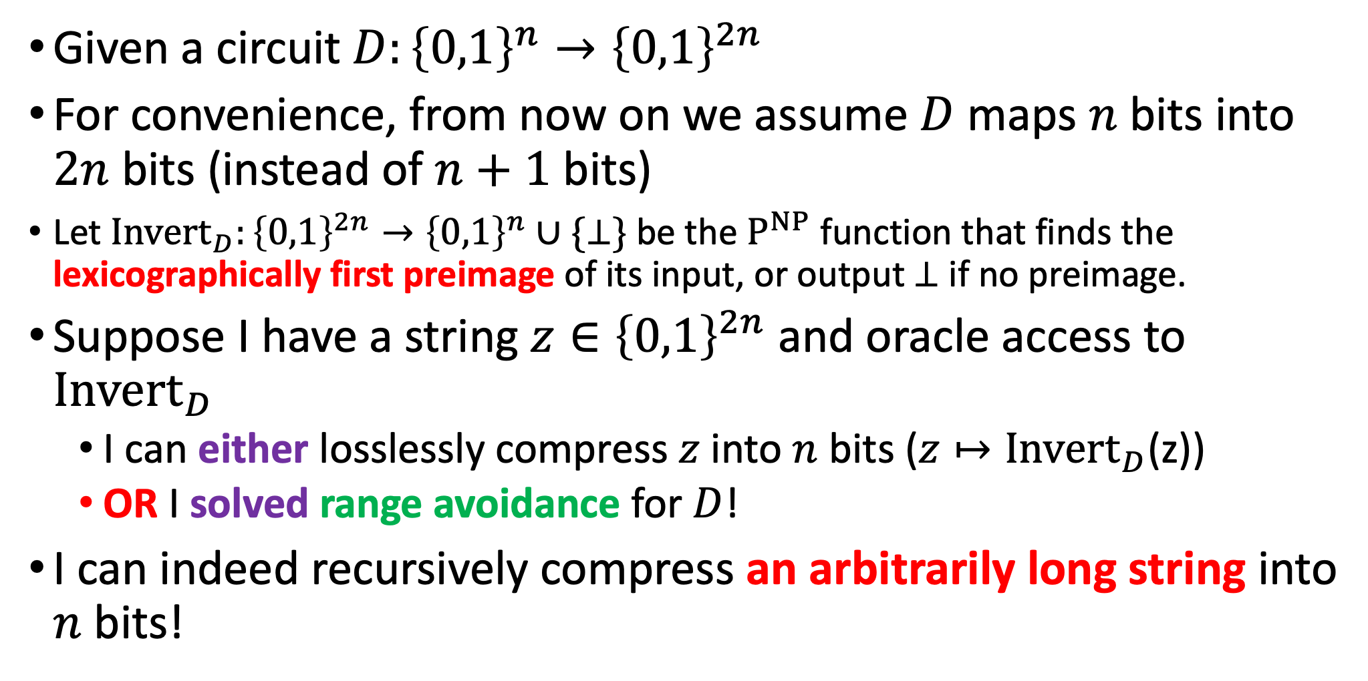
Some Intuition
Given a circuit $D:{\left\{0,1\right\}}^{n}→{\left\{0,1\right\}}^{2n}$
For convenience, from now on we assume $D$ maps $n$ bits into $2n$ bits (instead of $n+1$ bits)
Let ${Invert}_{D}:{\left\{0,1\right\}}^{2n}→{\left\{0,1\right\}}^{n}∪\{⊥\}$ be the $P^{NP}$ function that finds the lexicographically first preimage of its input, or output $⊥$ if no preimage.
Suppose I have a string $z∈{\left\{0,1\right\}}^{2n}$ and oracle access to ${Invert}_{D}$
I can either losslessly compress $z$ into $n$ bits ($z↦{Invert}_{D}$(z))
OR I solved range avoidance for $D$!
I can indeed recursively compress an arbitrarily long string into $n$ bits!

Slide 19
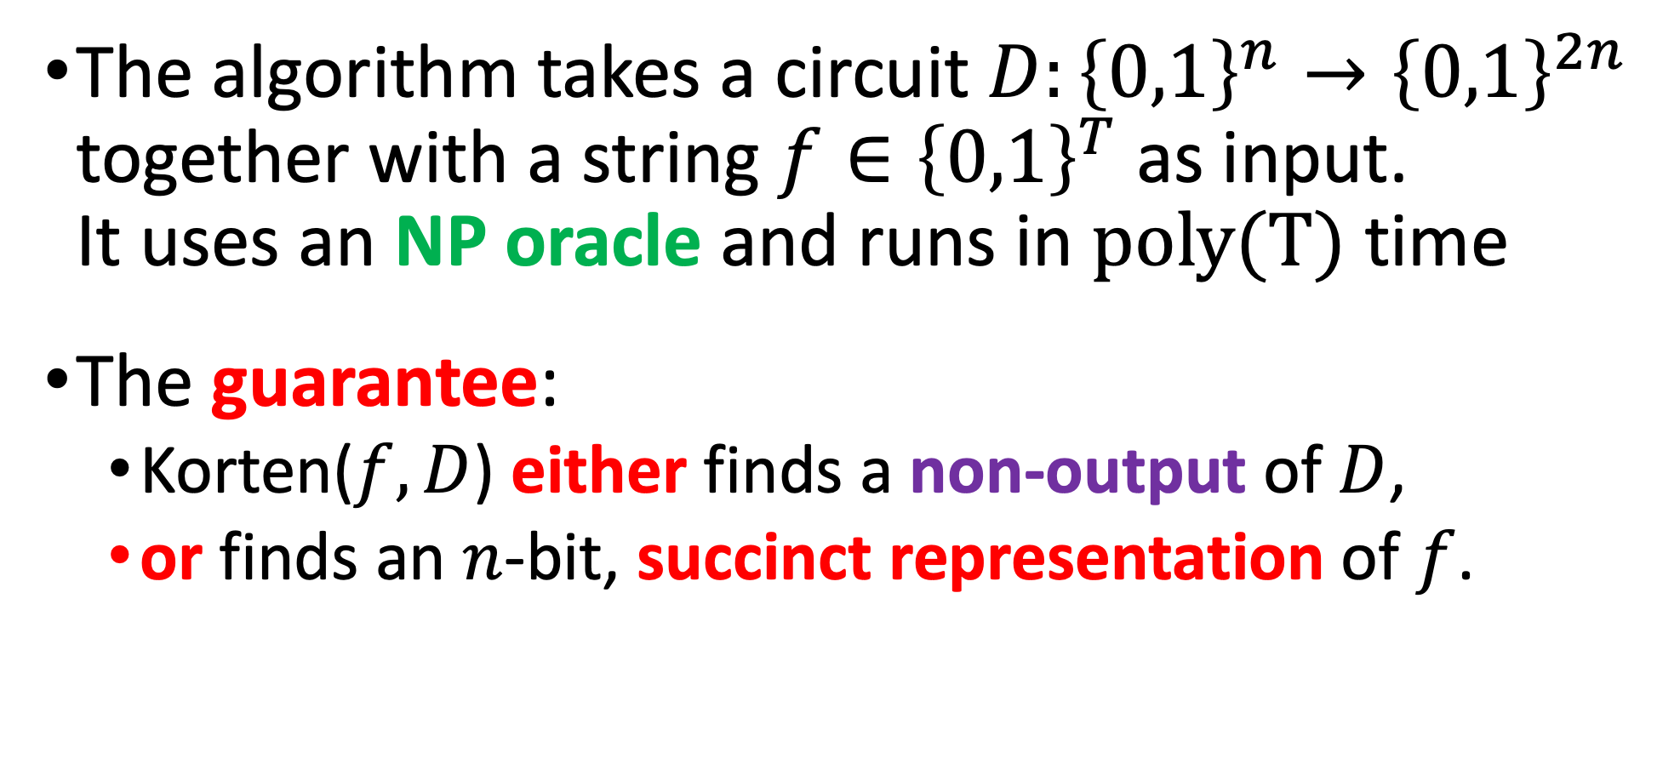

Korten’s algorithm: Korten($f,D$)
The algorithm takes a circuit $D:{\left\{0,1\right\}}^{n}→{\left\{0,1\right\}}^{2n}$ together with a string $f∈{\left\{0,1\right\}}^{T}$ as input. It uses an NP oracle and runs in $poly(T)$ time
The guarantee:
Korten($f,D$) either finds a non-output of $D$,
or finds an $n$-bit, succinct representation of $f$.

Slide 20
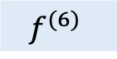
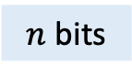
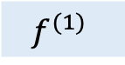
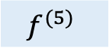
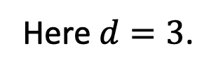
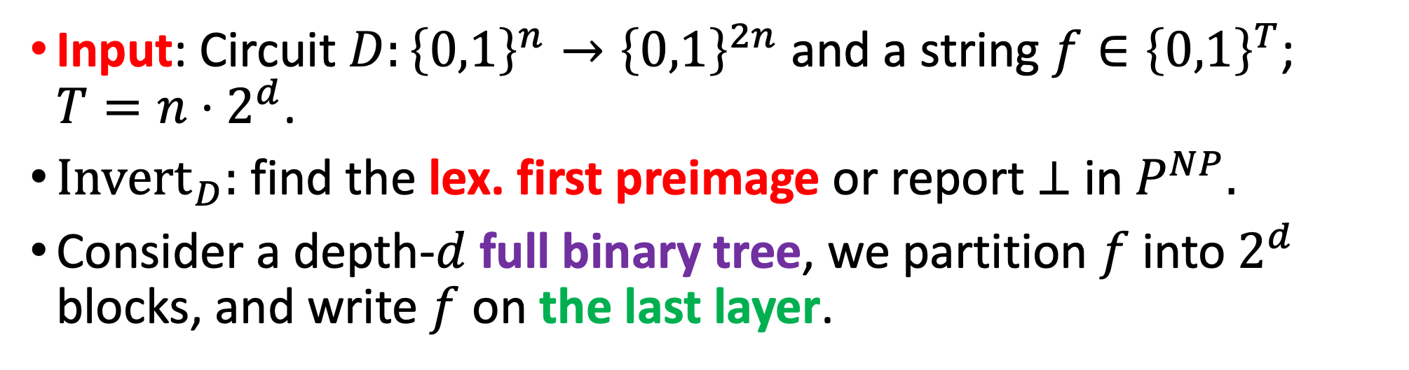
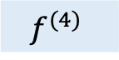
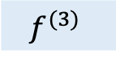
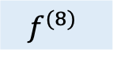
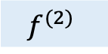
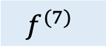
Input: Circuit $D:{\left\{0,1\right\}}^{n}→{\left\{0,1\right\}}^{2n}$ and a string $f∈{\left\{0,1\right\}}^{T}$; $T={n⋅2}^{d}$.
${Invert}_{D}:$ find the lex. first preimage or report $⊥$ in $P^{NP}.$
Consider a depth-$d$ full binary tree, we partition $f$ into $2^{d}$ blocks, and write $f$ on the last layer.
Here $d=3$.
$n$ bits
$$f^{(1)}$$
$$f^{(2)}$$
$$f^{(3)}$$
$$f^{(4)}$$
$$f^{(5)}$$
$$f^{(6)}$$
$$f^{(7)}$$
$$f^{(8)}$$
$$f=f^{(1)}∘f^{(2)}∘…∘f^{(7)}∘f^{(8)}$$

Slide 21

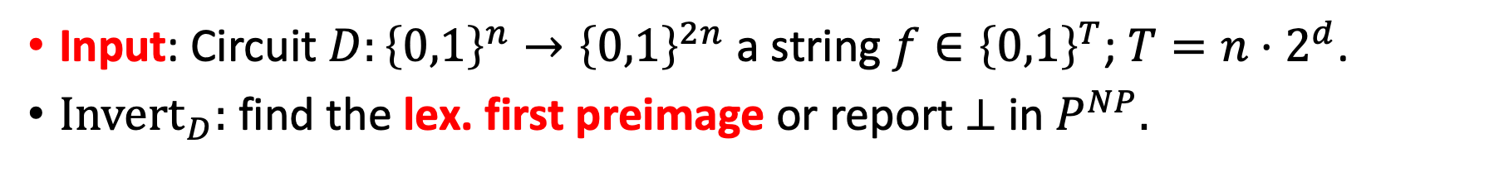
Input: Circuit $D:{\left\{0,1\right\}}^{n}→{\left\{0,1\right\}}^{2n}$ a string $f∈{\left\{0,1\right\}}^{T}$; $T=n⋅2^{d}$.
${Invert}_{D}:$ find the lex. first preimage or report $⊥$ in $P^{NP}.$
Korten($f,D$) from bottom (leaves) to top (root), and from left to right, try to fill in each intermediate node using ${Invert}_{D}$; stop if get $⊥$.
7
5
6
1
2
3
4
$$f^{(1)}$$
$$f^{(2)}$$
$$f^{(3)}$$
$$f^{(4)}$$
$$f^{(5)}$$
$$f^{(6)}$$
$$f^{(7)}$$
$$f^{(8)}$$
$$f=f^{(1)}∘f^{(2)}∘…∘f^{(7)}∘f^{(8)}$$

Slide 22
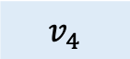
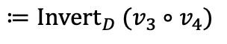
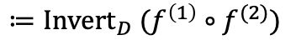
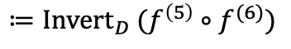
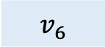

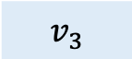
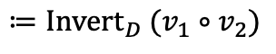
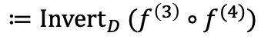
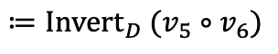
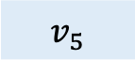
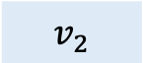
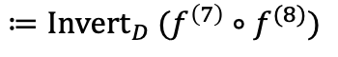

Input: Circuit $D:{\left\{0,1\right\}}^{n}→{\left\{0,1\right\}}^{2n}$ a string $f∈{\left\{0,1\right\}}^{T}$; $T=n⋅2^{d}$.
${Invert}_{D}:$ find the lex. first preimage or report $⊥$ in $P^{NP}.$
Korten($f,D$) from bottom (leaves) to top (root), and from left to right, try to fill in each intermediate node using ${Invert}_{D}$; stop if get $⊥$.
$v_{7}$
$$≔{Invert}_{D} (v_{5}∘v_{6})$$
$v_{5}$
$v_{6}$
$$≔{Invert}_{D} (v_{1}∘v_{2})$$
$$≔{Invert}_{D} (v_{3}∘v_{4})$$
$v_{1}$
$v_{2}$
$v_{3}$
$v_{4}$
$$≔{Invert}_{D} (f^{\left(1\right)}∘f^{(2)})$$
$$≔{Invert}_{D} (f^{\left(3\right)}∘f^{(4)})$$
$$≔{Invert}_{D} (f^{\left(5\right)}∘f^{(6)})$$
$$≔{Invert}_{D} (f^{\left(7\right)}∘f^{(8)})$$
$$f^{(1)}$$
$$f^{(2)}$$
$$f^{(3)}$$
$$f^{(4)}$$
$$f^{(5)}$$
$$f^{(6)}$$
$$f^{(7)}$$
$$f^{(8)}$$
$$f=f^{(1)}∘f^{(2)}∘…∘f^{(7)}∘f^{(8)}$$

Slide 23









Key Lemma
If the algorithm does not find a non-output of $D$ (i.e., it finds the root $v_{2^{d}−1}$), then $f$ has a $(\left|D\right|⋅d)$-size circuit. Hint: this is just GGM!
$v_{7}$
$$\left(v_{5}∘v_{6}\right)=D(v_{7})$$
$v_{5}$
$v_{6}$
$$\left(v_{3}∘v_{4}\right)=D(v_{6})$$
$$v_{1}$$
$$v_{2}$$
$v_{3}$
$v_{4}$
$$\left(f^{(5)}∘f^{(6)}\right)=D(v_{3})$$
$$f^{(5)}$$
$$f^{(6)}$$

Slide 24



Korten($f,D$): “Hardness vs Randomness”
If $f$ has no $(\left|D\right|⋅d)$-size circuits, then Korten($f,D$) finds a non-output of $D$.
Using a hard truth-table to solve a derandomization task.
[Nisan-Wigderson’94] [Impagliazzo-Wigderson’97]
If $f$ has no $poly(|D|)$-size circuits, then NW($f,D$) approximates $\underset{z}{Pr}[D\left(z\right)=1]$ within $±0.01$.

Slide 25











Key idea in [CHR’23] The Computational History of Korten($f,D$)
Korten($f,D$) from bottom (leaves) to top (root), and from left to right, try to fill in each intermediate node using ${Invert}_{D}$; stop if get $⊥$. $History\left(f,D\right)≔the values$ of all nodes in the end + “index of last node”
$⊥$
$History\left(f,D\right) =f^{(1)}∘f^{(2)}∘…∘f^{(7)}∘f^{(8)}∘v_{1}∘v_{2}∘v_{3}∘v_{4}∘ ⊥ ∘ ⊥ ∘ ⊥$ + ”5”
$⊥$
$⊥$
Korten($f,D$) = $v_{1}∘v_{2}$
$$v_{5}≔{Invert}_{D} (v_{1}∘v_{2})$$
$v_{1}$
$v_{2}$
$v_{3}$
$v_{4}$
$$≔{Invert}_{D} (f^{\left(1\right)}∘f^{(2)})$$
$$≔{Invert}_{D} (f^{\left(3\right)}∘f^{(4)})$$
$$≔{Invert}_{D} (f^{\left(5\right)}∘f^{(6)})$$
$$≔{Invert}_{D} (f^{\left(7\right)}∘f^{(8)})$$
$$f^{(1)}$$
$$f^{(2)}$$
$$f^{(3)}$$
$$f^{(4)}$$
$$f^{(5)}$$
$$f^{(6)}$$
$$f^{(7)}$$
$$f^{(8)}$$
$$f=f^{(1)}∘f^{(2)}∘…∘f^{(7)}∘f^{(8)}$$

Slide 26


[CHR’23]: Local Verification of $History\left(f,D\right)$
History($f,D$) is unique given $f$ and $D$.
History($f,D$) is the only string passing all $O(T⋅2^{n})$ local checks below:
They are local since each check only reads $O(n)$ bits from the history

Slide 27


[CHR’23]: Local Verification of $History\left(f,D\right)$
History($f,D$) is unique given $f$ and $D$.
History($f,D$) is the only string passing all $O(T⋅2^{n})$ local checks below:
$⊥?$
For all $i$ ”$v_{i}≠⊥$ if and only if $i<i^{∗}$”
(English version) Check that the algorithm ends at $v_{i^{∗}}$

Slide 28




[CHR’23]: Local Verification of $History\left(f,D\right)$
History($f,D$) is unique given $f$ and $D$.
History($f,D$) is the only string passing all $O(T⋅2^{n})$ local checks below:
$⊥?$
For all $i$ ”$v_{i}≠⊥$ if and only if $i<i^{∗}$”
For all $i<i^{∗}$ ${D(v}_{i})= (v_{ℓ}∘v_{r})$ AND $D\left(z\right)≠$ $(v_{ℓ}∘v_{r})$ for all $z<v_{i}$
$v_{i}$
$$v_{ℓ}$$
$$v_{r}$$
(English version) Check that $v_{i}={Invert}_{D}(v_{ℓ}∘v_{r})$

Slide 29




[CHR’23]: Local Verification of $History\left(f,D\right)$
History($f,D$) is unique given $f$ and $D$.
History($f,D$) is the only string passing all $O(T⋅2^{n})$ local checks below:
$⊥?$
For all $i$ ”$v_{i}≠⊥$ if and only if $i<i^{∗}$”
For all $i<i^{∗}$ ${D(v}_{i})= (v_{ℓ}∘v_{r})$ AND $D\left(z\right)≠$ $(v_{ℓ}∘v_{r})$ for all $z<v_{i}$
$v_{i}$
$$v_{ℓ}$$
$$v_{r}$$
$v_{i^{∗}}$
For $i=i^{∗}$ $D\left(z\right)≠$ $(v_{ℓ}∘v_{r})$ for all $z∈{\left\{0,1\right\}}^{n}$
$$v_{ℓ}$$
$$v_{r}$$
(English version) Check that $v_{i^{∗}}={Invert}_{D}\left(v_{ℓ}∘v_{r}\right)= ⊥$

Slide 30























[CHR’23]: The Starting Point
Input: Circuit $D:{\left\{0,1\right\}}^{n}→{\left\{0,1\right\}}^{2n}$; $\left|f\right|={2n⋅2}^{2n}$. $f$ is set to the concatenation of all $2n$-bit strings in lexicographical order.
Fact: Korten$(f,D)$ solves range avoidance for $D$ in $2^{O(n)}$ time.
$v_{7}$
$$≔{Invert}_{D} (v_{5}∘v_{6})$$
$v_{5}$
$v_{6}$
$$≔{Invert}_{D} (v_{1}∘v_{2})$$
$$≔{Invert}_{D} (v_{3}∘v_{4})$$
$v_{1}$
$v_{2}$
$v_{3}$
$v_{4}$
Must fail on this level
$$≔{Invert}_{D} (f^{\left(1\right)}∘f^{(2)})$$
$$≔{Invert}_{D} (f^{\left(3\right)}∘f^{(4)})$$
$$≔{Invert}_{D} (f^{\left(5\right)}∘f^{(6)})$$
$$≔{Invert}_{D} (f^{\left(7\right)}∘f^{(8)})$$
$$f^{(1)}$$
$$f^{(2)}$$
$$f^{(3)}$$
$$f^{(4)}$$
$$f^{(5)}$$
$$f^{(6)}$$
$$f^{(7)}$$
$$f^{(8)}$$
$$f=f^{(1)}∘f^{(2)}∘…∘f^{(7)}∘f^{(8)}$$

Slide 31

Single-valued $FΣ_{2}P$ Algorithm: Reminder
A single-valued $FΣ_{2}P$ algorithm $A$ is given by a deterministic $poly(n)$-time algorithm $V\left(x,w,y,z\right)$; we assume $\left|x\right|=n$; $\left|w\right|,\left|y\right|,\left|z\right|≤poly(n)$.
We say $A(x)$ outputs $w$, if $w$ is the unique string such that
$∃y ∀z$ $V\left(x,w,y,z\right)=1$.
Intuitions: $y$ is a proof for $“A\left(x\right)=w”$. Each $z$ corresponds to a condition that $y$ must satisfy.
$V$ is a verifier that ”checks” exponentially many conditions (for each $z$) on the proof $y$; accept only if all of them pass.

Slide 32





[CHR’23]: The Starting Point
Consider Circuit $D_{n}:{\left\{0,1\right\}}^{n}→{\left\{0,1\right\}}^{2n}$; $\left|f_{n}\right|={2n⋅2}^{2n}$. $f_{n}$ is set to the concatenation of all $2n$-bit strings in lexicographical order.
Suppose $h$ has $n^{100}$-size circuit
Let $h=History(f,D_{n})$; $\left|h\right|=2^{O(n)}$.
Korten$(f_{n},D_{n})$ in single-valued $FΣ_{2}P$
Proof for “Korten$(f_{n},D_{n})$ = $w$” $y=C_{h}$; $C_{h}$ is an $n^{100}$-size circuit, $i^{∗}$: last-node index in $tt(C_{h})$ $tt(C_{h})$ is supposed to be $History(f_{n},D_{n})$
The verifier $V(D_{n},w,y,z)$ (Using $∀z$) check that $tt(C_{h})$ satisfies all local checks on History($f,D$).
check that $w$ is the values on the children of node $v_{i^{∗} }$.

Slide 33





[CHR’23]: Suppose $h$ has $n^{100}$-size circuit
Proof for “Korten$(f_{n},D_{n})$ = $w$” $y=C_{h}$; $C_{h}$ is an $n^{100}$-size circuit, $i^{∗}$: last-node index in $tt(C_{h})$ $tt(C_{h})$ is supposed to be $History(f_{n},D_{n})$
The verifier $V(D_{n},w,y,z)$ (Using $∀z$) check that $tt(C_{h})$ satisfies all local checks on History($f,D$).
check that $w$ is the values on the children of node $v_{i^{∗} }$.
$V$ runs in $poly(n)$ time, since each local check only needs to read $O(n)$ bits from $tt(C_{h})$
If $tt(C_{h})$ passes all local checks, then $tt\left(C_{h}\right)=$ History($f,D$), so the values on the children of node $v_{i^{∗} }$is Korten$(f_{n},D_{n})$!

Slide 34




[CHR’23]: When $h$ has NO $n^{100}$-size circuit
$$h=History(f,D_{n})$$
If $f$ has no $(\left|D\right|⋅d)$-size circuits, then Korten($f,D$) finds a non-output of $D$.
Let $m=n^{50}$. $D_{m}:{\left\{0,1\right\}}^{m}→{\left\{0,1\right\}}^{2m}$ be a circuit of size $O(m)$. Korten$(h,D_{m})$ is a $2^{O(n)}$-time algorithm that solves
Range Avoidance for $D_{m}$. $2^{n}=2^{m^{1/50}}$. Sub-exponential time now!
[CHR’23]: perform a sophisticated case-analysis (the “iterative win-win”) that gradually improve the running time until it becomes polynomial (not the focus of this talk)

Slide 35

Key Idea from [Li’23]
Why do a Win-Win if you can JUST WIN?

Slide 36

The Key Idea from [Li’23]
[Li’23]
By modifying Korten $\left(f,D_{n}\right)$, $History\left(f,D_{n}\right)$ always has a small circuit. Therefore, the starting point always work!

Slide 37
























Korten($f,D$) (in BFS order)
from bottom (leaves) to top (root), and from left to right, try to fill in each intermediate node using ${Invert}_{D}$; stop if get $⊥$.
$v_{7}$
$$≔{Invert}_{D} (v_{5}∘v_{6})$$
$v_{5}$
$v_{6}$
$$≔{Invert}_{D} (v_{1}∘v_{2})$$
$$≔{Invert}_{D} (v_{3}∘v_{4})$$
$v_{1}$
$v_{2}$
$v_{3}$
$v_{4}$
$$≔{Invert}_{D} (f^{\left(1\right)}∘f^{(2)})$$
$$≔{Invert}_{D} (f^{\left(3\right)}∘f^{(4)})$$
$$≔{Invert}_{D} (f^{\left(5\right)}∘f^{(6)})$$
$$≔{Invert}_{D} (f^{\left(7\right)}∘f^{(8)})$$
$$f^{(1)}$$
$$f^{(2)}$$
$$f^{(3)}$$
$$f^{(4)}$$
$$f^{(5)}$$
$$f^{(6)}$$
$$f^{(7)}$$
$$f^{(8)}$$
$$f=f^{(1)}∘f^{(2)}∘…∘f^{(7)}∘f^{(8)}$$

Slide 38
























Korten($f,D$) (in DFS order)
from left to right, try to fill in each intermediate node using ${Invert}_{D}$; also try to fill in a node immediately after its two children are filled;
stop if get $⊥$.
$$v_{15}$$
$$v_{7}$$
$$≔{Invert}_{D} (v_{7}∘v_{14})$$
$$v_{14}$$
$$≔{Invert}_{D} (v_{3}∘v_{6})$$
$$≔{Invert}_{D} (v_{10}∘v_{13})$$
$$v_{3}$$
$$v_{6}$$
$$v_{10}$$
$$v_{13}$$
$$≔{Invert}_{D} (v_{1}∘v_{2})$$
$$≔{Invert}_{D} (v_{4}∘v_{5})$$
$$≔{Invert}_{D} (v_{8}∘v_{9})$$
$$≔{Invert}_{D} (v_{11}∘v_{12})$$
$$v_{1}$$
$$v_{2}$$
$$v_{4}$$
$$v_{5}$$
$$v_{8}$$
$$v_{9}$$
$$v_{11}$$
$$v_{12}$$

Slide 39





Korten($f,D$) in DFS order from left to right, try to fill in each intermediate node using ${Invert}_{D}$; also try to fill in a node immediately after its two children are filled;
stop if get $⊥$. $History\left(f,D\right)≔values$ of all nodes in the end + “index of last node”
$$⊥$$
$$v_{7}$$
$$⊥$$
$$v_{3}$$
$$v_{6}$$
$$v_{10}$$
$$⊥$$
$$⊥$$
$$v_{4}$$
$$v_{5}$$
$$v_{8}$$
$$v_{9}$$
11
$$v_{11}$$
12
$$v_{1}$$
$$v_{2}$$
$$v_{12}$$

Slide 40

















Input: Circuit $D_{n}:{\left\{0,1\right\}}^{n}→{\left\{0,1\right\}}^{2n}$; $\left|f_{n}\right|={2n⋅2}^{2n}$. $f$ is set to the concatenation of all $2n$-bit strings in lexicographical order.
Lemma
History($f,D$) always has a small circuit.
$$⊥$$
7
$$v_{7}$$
$$⊥$$
3
6
10
$$v_{3}$$
$$v_{6}$$
$$v_{10}$$
$$⊥$$
1
2
4
5
8
9
11
12
$$v_{1}$$
$$v_{2}$$
$$v_{4}$$
$$v_{5}$$
$$v_{8}$$
$$v_{9}$$
$$v_{11}$$
$$v_{12}$$
Proof by picture: storing all the red blocks gives a $poly(n,|D|)$-size circuit for History($f,D$)

Slide 41










Local Verification of $History\left(f,D\right)$ in DFS order
History($f,D$) is unique given $f$ and $D$.
History($f,D$) is the only string passing all $O(T⋅2^{n})$ local checks below:
They are local since each check only read $O(n)$ bits from the history
$⊥?$
For all $i$ ”$v_{i}≠⊥$ if and only if $i<i^{∗}$”
For all $i<i^{∗}$ ${D(v}_{i})= (v_{ℓ}∘v_{r})$ AND $D\left(z\right)≠$ $(v_{ℓ}∘v_{r})$ for all $z<v_{i}$
$v_{i}$
$$v_{ℓ}$$
$$v_{r}$$
$v_{i^{∗}}$
For $i=i^{∗}$ $D\left(z\right)≠$ $(v_{ℓ}∘v_{r})$ for all $z∈{\left\{0,1\right\}}^{n}$
$$v_{ℓ}$$
$$v_{r}$$

Slide 42

Open Questions
Can we prove maximum circuit lower bounds for MAEXP, AMEXP, or PPEXP?
Can we prove almost-everywhere lower bounds for MA, AM, or PP?
Any chance of proving non-trivial circuit lower bounds for $E^{NP}$ using range avoidance?

Slide 43
Thanks!

